Slide 1
Addressing heterogeneity, failures and variability in high-performance NoCs
José Duato
Parallel Architectures Group (GAP)
Technical University of Valencia (UPV)
Spain

Slide 2
Outline
Current proposals for NOCs
Sources of heterogeneity
Current designs
Our proposal
Addressing bandwidth constraints
Addressing heat dissipation
The role of HyperTransport and QPI
Some current research efforts
Conclusions

Slide 3
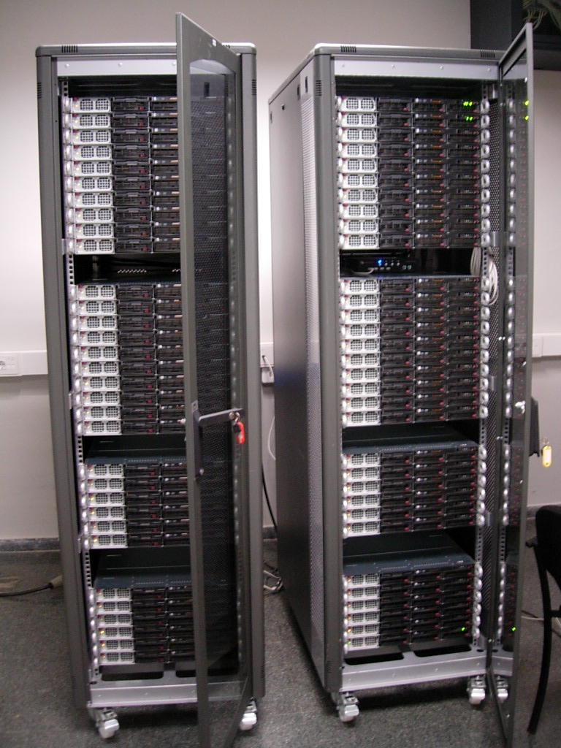
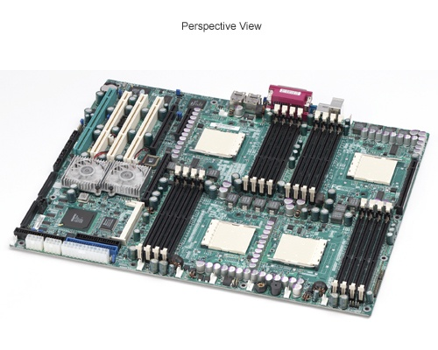
Current Server Configurations
Cluster architectures based on 2- to 8-way motherboards with 4-core chips

Slide 4
What is next?
Prediction is very difficult, especially about the future (Niels Bohr, physicist, 1885-1962)
Extrapolating current trends, the number of cores per chip will increase at a steady rate
Main expected difficulties
  Communication among cores
    Buses and crossbars do not scale
    A Network on Chip (NoC) will be required

Slide 5
What is next?
Main expected difficulties
  Heat dissipation and power consumption
    Known power reduction techniques already implemented in the cores
    Either cores are simplified (in-order cores) or better heat extraction techniques are designed
  Memory bandwidth and latency
    VLSI technology scales much faster than package bandwidth
    Multiple interconnect layers increase memory latency
    Optical interconnects, proximity communication, and 3D stacking address this problem

Slide 6
Most current proposals for NOCs…
Homogeneous systems
  Regular topologies and simple routing algorithms
  Load balancing strategies become simpler
  A single switch design for all the nodes
Goals
  Minimize latency
  Minimize resource consumption (silicon area)
  Minimize power consumption
  Automate design space exploration

Slide 7
Most current proposals…
Inherit solutions from first single-chip switches
  Wormhole switching
    Low latency
    Small buffers (low area and power requirements)
  2D meshes
    Match the 2D layout of current chips
    Minimize wiring complexity
  Dimension-order routing
    Implemented with a finite-state machine (low latency, small area)

Slide 8
Most current proposals…
L2$ (data)
node
L1I$
L1C$
L2$ (tags)
CPU core
Router
L1D$
L2C$
L2$ (tags)
L2$ (data)
DOR path
Local
processor
small
buffers
N
Buffers
E
W
router
FSM
Rout.
unit
Arb
S

Slide 9
Sources of Heterogeneity
Architectural sources
  Access to external memory
  Devices with different functionalities
  Use of accelerators
  Simple and complex cores
Technology sources
  Manufacturing defects
  Manufacturing process variability
  Thermal issues
  3D stacking
Usage model sources
  Virtualization
  Application specific systems

Slide 10
Architectural sources
Due to the existence of different kinds of devices
Access to external memory
  On-chip memory controllers
  Different number of cores and memory controllers
    Example: GPUs with hundreds of cores and less than ten memory controllers

Slide 11
Architectural sources
DRAM
DRAM
DRAM
DRAM
memory controller
core/cache
congestion

Slide 12
Architectural sources
Access to external memory
  On-chip memory controllers
  Different number of cores and memory controllers
    Example: GPUs with hundreds of cores and less than ten memory controllers
  Consequences
    Heterogeneity in the topology
    Asymmetric traffic patterns
    Congestion when accessing memory controllers

Slide 13
Architectural sources
Devices with different functionalities
  Cache blocks with different sizes and shapes (than processor cores)

Slide 14
Architectural sources
$
$
$
MC
$
$
$
$
$
$
MC
MC
$
$
$
$
$
MC
$
$

Slide 15
Architectural sources
Devices with different functionalities
  Cache blocks with different sizes and shapes (than processor cores)
  Consequences
    Heterogeneity in the topology
    Asymmetric traffic patterns
      Different link bandwidths might be required
      Different networks might be required (e.g. 2D mesh + binary tree)

Slide 16
Architectural sources
Using accelerators
  Efficient use of available transistors
  Increases the Flops/Watt ratio
  Next device: GPU (already planned by AMD)

Slide 17
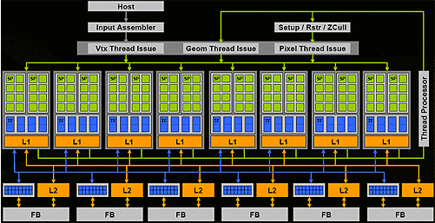
Architectural sources

Slide 18
Architectural sources
Using accelerators
  Efficient use of available transistors
  Increases the Flops/Watt ratio
  Next device: GPU (already planned by AMD)
Simple and complex cores
  Few complex cores to run sequential applications efficiently
  Simple cores to run parallel applications and increase Flops/watt ratio
  Example: Cell processor

Slide 19
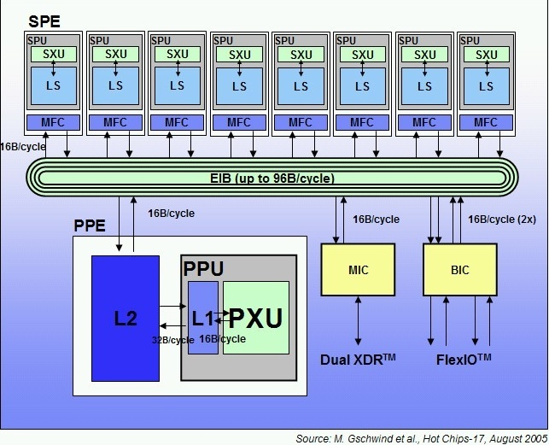
Architectural sources

Slide 20
Architectural sources
Using accelerators
  Efficient use of available transistors
  Increases the Flops/Watt ratio
  Next device: GPU (already planned by AMD)
Simple and complex cores
  Few complex cores to run sequential applications efficiently
  Simple cores to run parallel applications and increase Flops/watt ratio
  Example: Cell processor
Consequences
  Heterogeneity in the topology (different sizes)
  Asymmetric traffic patterns

Slide 21
Architectural sources

Slide 22
Architectural sources

Slide 23
Technology sources
Manufacturing defects
  Increase with integration scale
  Yield may drop unless fault tolerance solutions are provided
  Solution: use alternative paths (fault tolerant routing)
Consequences
  Asymmetries introduced in the use of links (deadlock issues)

Slide 24
Technology sources
B
A

Slide 25
Technology sources
Manufacturing process variability
  Smaller transistor size Increased process variability
    Variations in L_{eff} Variations in V_{th}
    Variations in wire dimensions Resistance and capacitance variations
    Variations in dopant levels Variations in V_{th}
  Clock frequency fixed by slowest device
  Unacceptable as variability increases

Slide 26
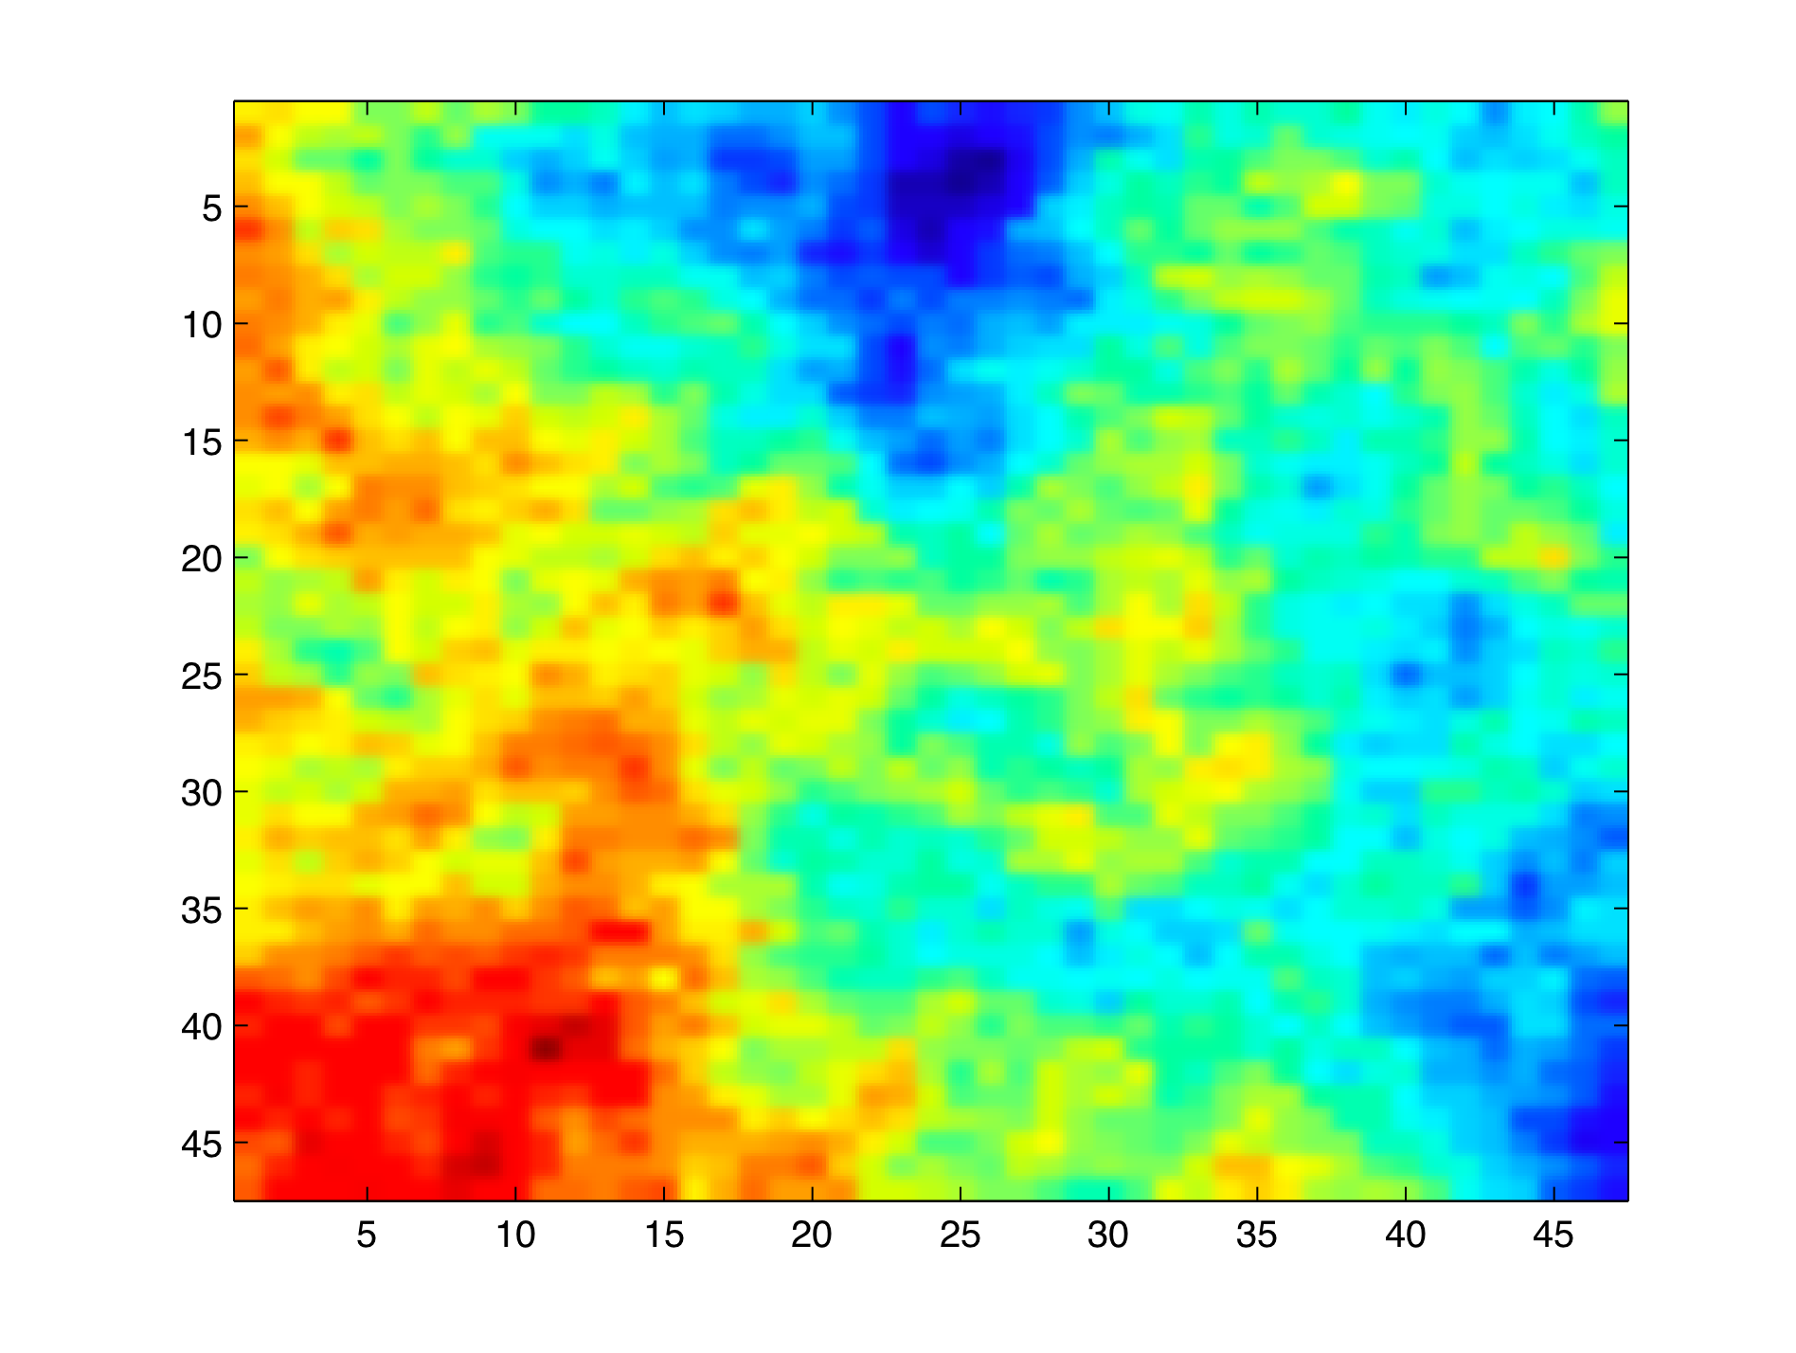
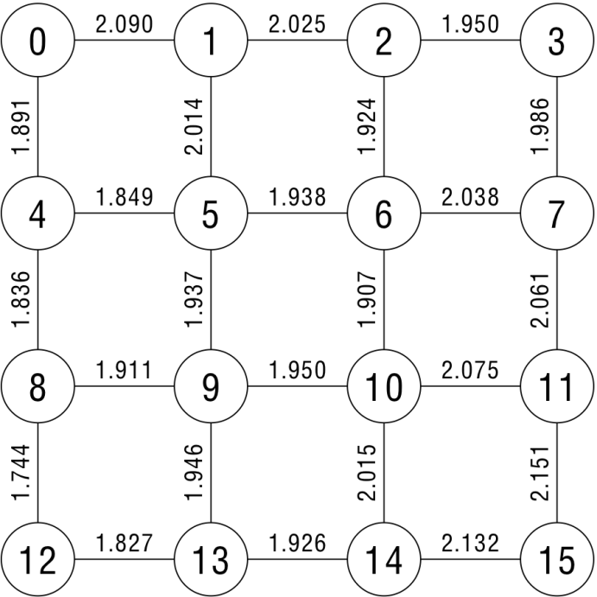
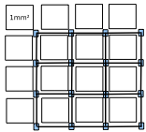
Systematic front-end variability
  Link frequency/delay distributions in NoC topology (32nm 4x4 NoC)
Lgate map
Notes:
The results of the systematic front-end delay variations are shown in this figure. On one hand we generate maps of Lgate in the chip surface. The figure in the left, where blue area represent small lgate vaules and red area represent big lgate values. With this figure and the location of the links in the floorplan, we make spice simulations to obtain the final delay (and consequently the operating frequency) of each link in the network as is shown in the 4x4 NoC topology shown at right top. It is possible to see how will exist considerable differences in frequency of each link. This will infered communication bottlenecks when a GALS based communicating scheme is used.

Slide 27
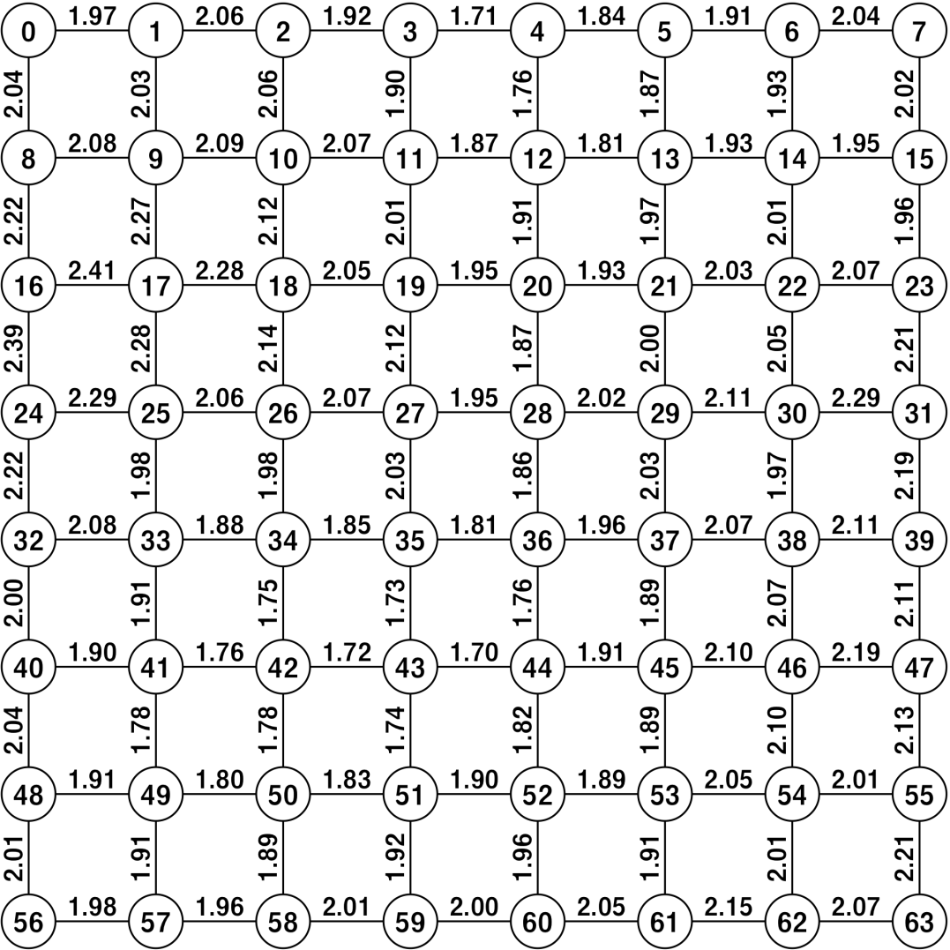
Systematic front-end variability
  Link frequency/delay distributions in NoC topology (32nm 8x8 NoC)
In larger networks the scenario is even worse
Notes:
WE have also obtained results for 8x8 topologies where the communication scenario is even worse. In this picture we can oberve how a slow zone (the red one) is surronded by core inecting
Packets at higher frequencies causing considerable contention.

Slide 28
Technology sources
Manufacturing process variability
  Possible solutions
    Different regions with different speeds
    Links with different speeds
    Disabled links and/or switches
  Consequences
    Unbalanced link utilization
    Irregular topologies

Slide 29
Technology sources
Thermal issues
  More transistors integrated as long as they are not active at the same time
  Temperature controllers will dynamically adjust clock frequency for different clock domains
Consequences
  Functional heterogeneity
  Performance drops due to congested (low bandwidth) subpaths (passing through slower regions)

Slide 30
Technology sources
3D stacking
  The most promising technology to alleviate the memory bandwidth problem
  Will aggravate the temperature problem (heat dissipation)
Consequences
  Traffic asymmetries (# vias vs wires in a chip)

Slide 31
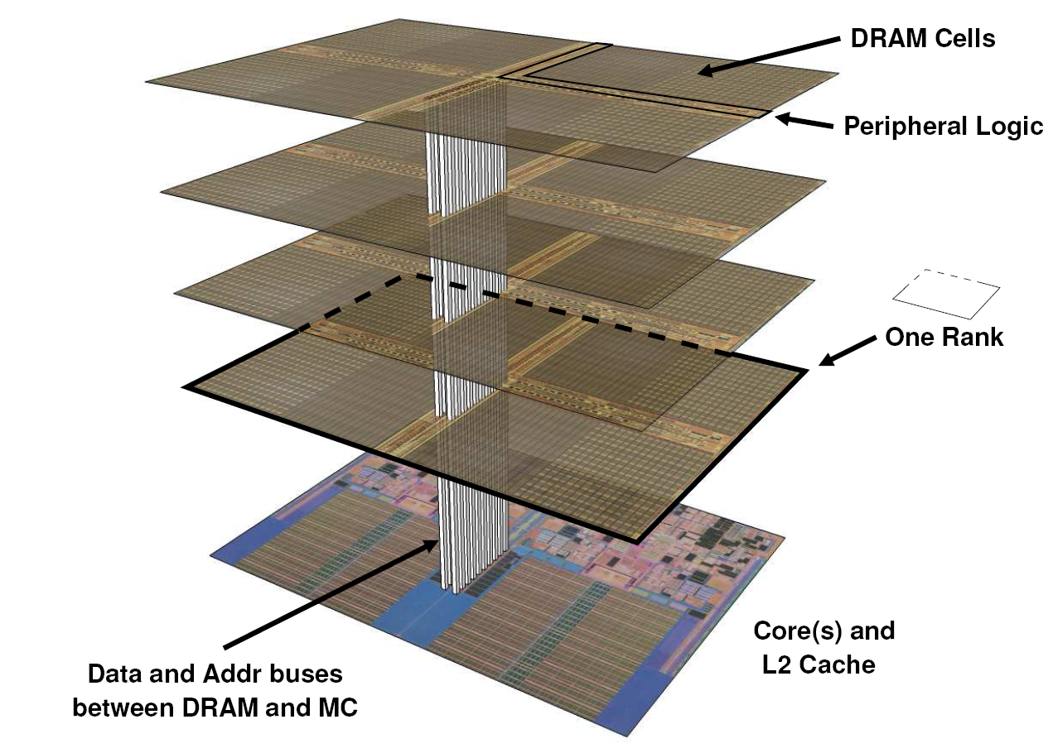
Technology sources
Courtesy of Gabriel Loh, ISCA 2008

Slide 32
Usage Model sources
Virtualization
  Enables running applications from different customers in the same computer while guaranteeing security and resource availability
  Resources dynamically assigned (increases utilization)
  At the on-chip level
    Traffic isolation between regions
      Deadlock issues (routing becomes complex)
      Shared caches introduce interferences among regions
      Memory controllers need to be shared

Slide 33
Usage Model sources
B
A
B
A

Slide 34
Usage Model sources
Application specific systems
  The application to run is known beforehand (embedded systems)
    Non-uniform traffic and some links may not be required
  Heterogeneity can lead to silicon area and power savings

Slide 35
Usage Model sources
Communication Graph
Network Topology
Application
to be mapped
T2
P1
P2
P3
P4
T1
Mapping
Function
T4
T3
P5
P6
P7
Tn
APSRA
P8
P9
P10
P11
P12
P13
Routing
Tables
Compression
Compressed
Routing
Tables
Courtesy of Maurizio Palesi
and Shashi Kumar, CODES 2006

Slide 36
Current Designs
Current trends when designing the NoC
  Topology: 2D mesh (fits the chip layout)
  Switching: wormhole (minimum area requirements for buffers)
  Routing: implemented with logic (FSM finite-state-machine), DOR
    Low latency, area and power efficient
    But, … not suitable for new challenges
      Manufacturing defects
      Virtualization
      Collective communication
      Power management
N
WH: small buffers
no VCs
Buffers
E
W
FSM logic
(DOR)
Rout.
unit
Arb
S

Slide 37
Our Proposal
bLBDR (Broadcast Logic-Based Distributed Routing)
  Removes routing tables both at source nodes and switches
  Enables
    FSM-based (low-latency, power/area efficient) unicast routing
    Tree-based multicast/broadcast routing with no need for tables
    Most irregular topologies (i.e. for manufacturing defects) are supported
      Most topology-agnostic routing algorithms supported (up*/down*, SR)
      DOR routing in a 2D mesh topology is supported
    Definition of multiple regions for virtualization and power management

Slide 38
System environment
For bLBDR to be applied, some conditions must be met:
  Message headers must contain X and Y offsets, and every switch must know its own coordinates
  Every end node can communicate with any other node through a minimal path
bLBDR, on the other hand:
  Can be applied on systems with or without virtual channels
  Supports both wormhole and virtual cut-through switching

Slide 39
Our Proposal
  FSM-based implementation
    A set of AND, OR, NOT gates
    2 flags per switch output port for routing
    An 8-bit register per switch output port for topology/regions definition

Slide 40
Description

Slide 41
Description (2)

Slide 42
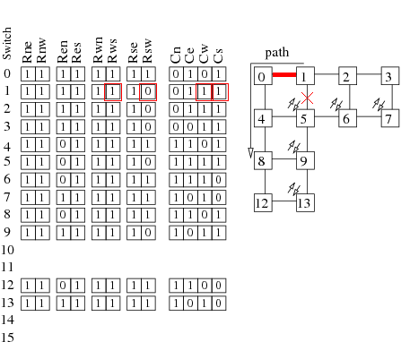
Description (3)

Slide 43
Performance
8x8 mesh, TSMC library 90nm technology (we thank Maurizio Palesi for the evaluation results)

Slide 44
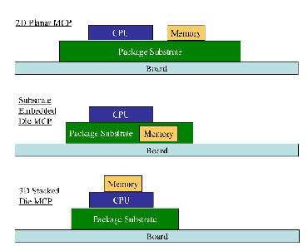
Addressing Bandwidth Constraints
3D stacking of DRAM seems the most viable and effective approach

Slide 45
DRAM and Cores in a Single Stack
Courtesy of Gabriel Loh, ISCA 2008

Slide 46
Addressing Heat Dissipation
Most feasible techniques to reduce power consumption have already been implemented in current cores
Increasing the number of cores will increase power consumption. Options are:
  Using simpler cores (e.g. in-order cores)
    Niagara 2 has a chip TDP of 95W, and a core TDP of 5.4W, which results in a 32nm scaled core TDP of 1.1W
    Atom has a chip TDP of 2.5W, and a core TDP of 1.1W, which results in a 32nm scaled core TDP of 0.5W
  Using new techniques to increase heat dissipation
    Liquid cooling inside the chip

Slide 47
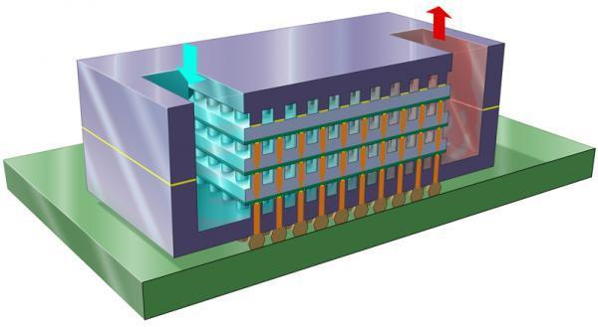
Handling Heat Dissipation

Slide 48
The Role of HyperTransport and QPI
Tiled architectures reduce design cost and NoC size, and share memory controllers

Slide 49
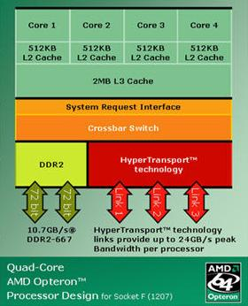
The Role of HyperTransport and QPI
Tile architecture versus 4-core Opteron architecture: HT/QPI-based NoCs?

Slide 50
Reducing Design Cost and Time to Market
Instead of stacking a multi-core die and several DRAM dies...
Silicon carrier with multiple (smaller) multi-core dies and 3D DRAM stacks
  Shorter time to market. Just shrink current dies to next VLSI technology
  Better heat distribution, yield, and fault tolerance
  Opportunities for design space exploration and optimizations
    Number of dies of each kind, component location, interconnect patterns, etc.
  Two-level interconnect: network on-chip and network on-substrate
    Network on-substrate: Not a new concept; already implemented in SoCs
    Network on-substrate implemented with metal layers or silicon waveguides
    Perfect fit for HT/QPI: current chip-to-chip interconnects moved to substrate

Slide 51
Example Based on 4-Core Opteron

Slide 52
Example Based on 4-Core Opteron

Slide 53
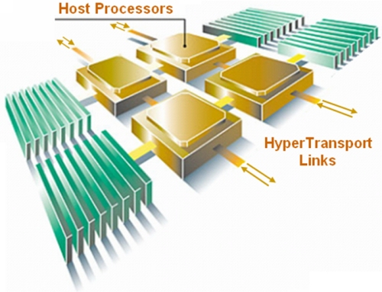
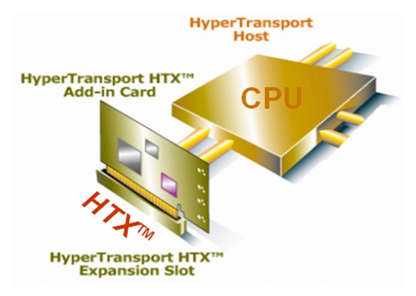
Some Current Research Efforts
Implementation and evaluation of High Node Count HT extensions...

Slide 54
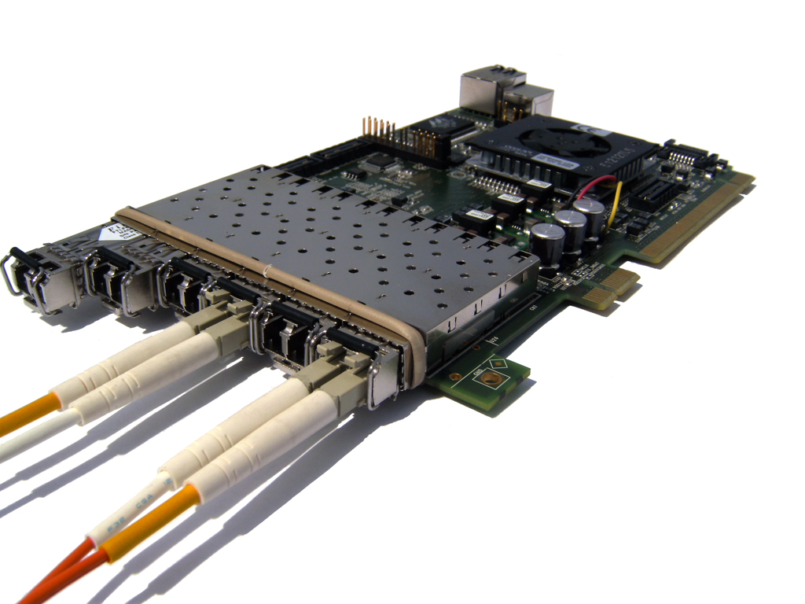
Some Current Research Efforts
… based on HTX reference card from University of Heidelberg, to model at system level what in the future will be within a single package

Slide 55
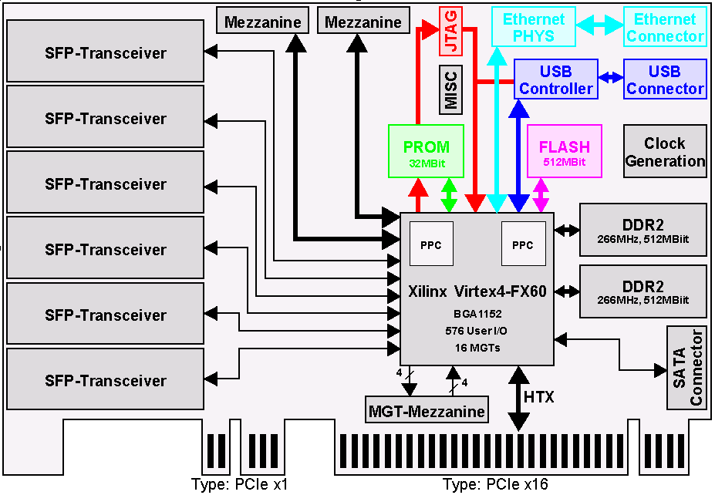
Some Current Research Efforts
The FPGA implements protocol translation, matching store, routing, and NI

Slide 56
Expected Results
Working prototype with 1024 cores
  FPGA implementation of protocol translation to HNCHT
  Optimized libraries for MPI and GASNet
  Evaluation with sample parallel applications
  Extension of cache coherence protocols for using remote memory
Limitations
  Cache coherence protocols not scalable
  Long latency when accessing remote memory
  Low bandwidth when accessing remote memory with load/store (limited by MSHRs and load-store queue size in the Opteron)

Slide 57
Conclusions
Future multi-core chips face three big challenges: power consumption (and heat dissipation), memory bandwidth, and on-chip interconnects
Despite the simplicity and beauty of homogeneous designs, designers will be forced to consider heterogeneity
There exist many sources of heterogeneity, imposed by either architecture, technology, or usage models. No way to escape!
It is very challenging, but not impossible, to provide efficient, cost-effective architectural support for heterogeneity in a NoC
Some solutions have been proposed for heat dissipation. The question is whether they will become cost effective
3D stacking is the most promising approach to address memory bandwidth. Two flavors (single and multiple stacks) offer very different trade-offs
HT/QPI fits very well with on-chip and on-substrate interconnect requirements

Slide 58
Thank you!
Addressing heterogeneity, failures and variability in high-performance NoCs
José Duato
Parallel Architectures Group (GAP)
Technical University of Valencia (UPV)
Spain

