Slide 1
AlphaZ: A System for Design Space Exploration in the Polyhedral Model
Tomofumi Yuki, Gautam Gupta, DaeGon Kim, Tanveer Pathan, and Sanjay Rajopadhye

Slide 2
Polyhedral Compilation
The Polyhedral Model
Now a well established approach for automatic parallelization
Based on mathematical formalism
Works well for regular/dense computation
Many tools and compilers:
PIPS, PLuTo, MMAlpha, RStream, GRAPHITE(gcc), Polly (LLVM), ...

Slide 3
Design Space (still a subset)
Space Time + Tiling: schedule + parallel loops
Primary focus of existing tools
Memory Allocation
Most tools for general purpose processors do not modify the original allocation
Complex interaction with space time
Higher-level Optimizations
Reduction detection
Simplifying Reduction (complexity reduction)
Notes:
Note that this is still a subset
You can quote Thies for difficulty of doing schedule + memory allocation all at once

Slide 4
AlphaZ
Tool for Exploration
Provides a collection of analyses, transformations, and code generators
Unique Features
Memory Allocation
Reductions
Can be used as a push-button system
e.g., Parallelization à la PLuTo is possible
Not our current focus
Notes:
I know there is much more to say about AlphaZ, but time is limited…

Slide 5
This Paper: Case Studies
adi.c from PolyBench
Re-considering memory allocation allows the program to be fully tiled
Outperforms PLuTo that only tiles inner loops
UNAfold (RNA folding application)
Complexity reduction from O(n⁴) to O(n³)
Application of the transformations is fully automatic

Slide 6
This Talk: Focus on Memory
Tiling requires more memory
e.g., Smith-Waterman dependence
Sequential
Tiled

Slide 7
ADI-like Computation
Updates 2D grid with outer time loop
PLuTo only tiles inner two dimensions
Due to a memory based dependence
With an extra scalar, becomes tilable in all three dimensions
PolyBench implementation has a bug
It does not correctly implement ADI
ADI is not tilable in all dimensions
Notes:
The amount of memory required is not scalar, due to other statements.
Mention the bug, and we exploit it, and we found it out after submitting the abstract, and we still use it because the story doesn’t change

Slide 8
adi.c: Original Allocation
for (t=0; t < tsteps; t++) {
for (i1 = 0; i1 < n; i1++)
for (i2 = 0; i2 < n; i2++)
X[i1][i2] = foo(X[i1][i2], X[i1][i2-1], …)
…
for (i1 = 0; i1 < n; i1++)
for (i2 = n-1; i2 >= 1; i2--)
X[i1][i2] = bar(X[i1][i2], X[i1][i2-1], …)
…
}
for (t=0; t < tsteps; t++) {
for (i1 = 0; i1 < n; i1++)
for (i2 = 0; i2 < n; i2++)
X[i1][i2] = foo(X[i1][i2], X[i1][i2-1], …)
…
for (i1 = 0; i1 < n; i1++)
for (i2 = n-1; i2 >= 1; i2--)
X[i1][i2] = bar(X[i1][i2], X[i1][i2-1], …)
…
}
Not tilable because of the reverse loop
Memory based dependence: (i1,i2 -> i1,i2+1)
Require all dependences to be non-negative
Notes:
When presenting ADI, the tilability problem should be re-casted as being able to (re-)reverse the second i2 loop

Slide 9
adi.c: Original Allocation
for (i2 = 0; i2 < n; i2++)
S1: X[i1][i2] = foo(X[i1][i2], X[i1][i2-1], …)
…
for (i2 = n-1; i2 >= 1; i2--)
S2: X[i1][i2] = bar(X[i1][i2], X[i1][i2-1], …)
…
S1 X[i1]
S2 X[i1]
Notes:
When presenting ADI, the tilability problem should be re-casted as being able to (re-)reverse the second i2 loop

Slide 10
adi.c: With Extra Memory
Once the two loops are fused:
Value of X only needs to be preserved for one iteration of i2
We don’t need a full array X’, just a scalar
for (i2 = 0; i2 < n; i2++)
S1: X[i1][i2] = foo(X[i1][i2], X[i1][i2-1], …)
…
for (i2 = 1; i2 < n; i2++)
S2: X’[i1][i2] = bar(X[i1][i2], X[i1][i2-1], …)
…
X[i1]
X’[i1]
Notes:
For simplicity of presentation, introducing big 2D array

Slide 11
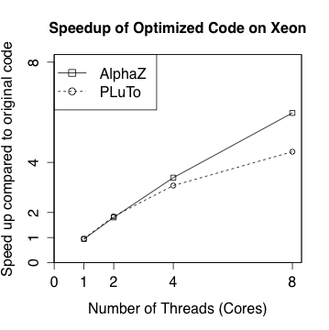
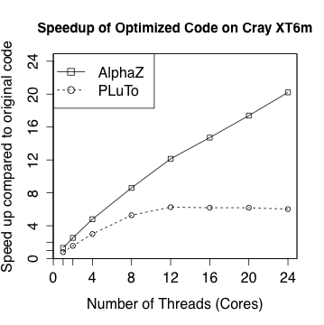
adi.c: Performance
PLuTo does not scale because the outer loop is not tiled
Notes:
adi.c through pluto –tile –parallel (--noprevector for Cray)
adi.ab extracted from adi.c with tiling + simple memory allocation. (The experiment actually uses 2N^2 more memory)
gcc –O3 and craycc –O3

Slide 12
UNAfold
UNAfold [Markham and Zuker 2008]
RNA secondary structure prediction algorithm
O(n³) algorithm was known [Lyngso et al. 1999]
too complicated to implement
“good enough” workaround exists
AlphaZ
Systematically transform O(n⁴) to O(n³)
Most of the process can be automated

Slide 13
UNAFold: Optimization
Key: Simplifying Reductions [POPL 2006]
Finds “hidden scans” in reductions
Rare case: compiler can reduce complexity
Almost automatic:
The O(n⁴) section must be separated
many boundary cases
Require function to be inlined to expose reuse
Transformations to perform the above is available; no manual modification of code

Slide 14
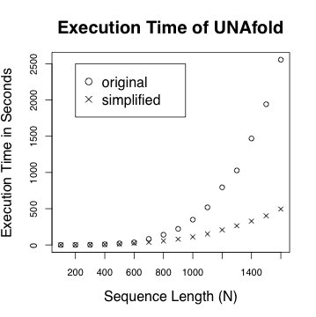
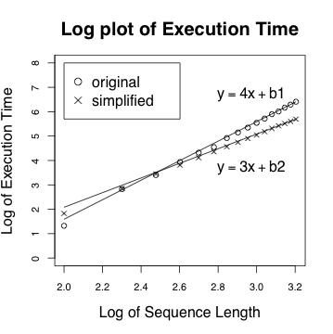
UNAfold: Performance
Complexity reduction is empirically confirmed
Notes:
original is unmodified mfold, gcc –O3
simplified replaces a function (fill_matrices_1) with AlphaZ generated code
memory and schedule is something I found in 5 min, not very optimized
no loop transformation was performed

Slide 15
AlphaZ System Overview
Target Mapping:
Specifies schedule, memory allocation, etc.
Alpha
C
C+OpenMP
Polyhedral Representation
Transformations
C+CUDA
Analyses
Target Mapping
Code Gen
C+MPI
Notes:
The main point in this slide is that the user interacts with the system, and has full control over the operations.
One thing not visible in the figure but is important is that the user can specify TM.
It is probably useful to mention the adi example did take the CtoAlphabets path.

Slide 16
Human-in-the-Loop
Automatic parallelization—“holy grail” goal
Current automatic tools are restrictive
A strategy that works well is “hard-coded”
difficult to pass domain specific knowledge
Human-in-the-Loop
Provide full control to the user
Help finding new “good” strategies
Guide the transformation with domain specific knowledge
Notes:
note sure where to place this slide

Slide 17
Conclusions
There are more strategies worth exploring
some may currently be difficult to automate
Case Studies
adi.c: memory
UNAfold: reductions
AlphaZ: Tool for trying out new ideas
Notes:
future work related to higher level abstractions; semantic tiling, Galois-like abstractions.

Slide 18
Acknowledgements
AlphaZ Developers/Users
Members of Mélange at CSU
Members of CAIRN at IRISA, Rennes
Dave Wonnacott at Haverford University and his students

Slide 19
Key: Simplifying Reductions
Simplifying Reductions [POPL 2006]
Finds “hidden scans” in reductions
Rare case: compiler can reduce complexity
Main idea:
can be written
O(n²)
O(n)

