Slide 1


Assessing the Impact of Imperfect Diagnosis on Service Reliability:
A Parsimonious Model Approach
(Presenter) Jesper Grønbæk 
Hans-Peter Schwefel  
Jens Kristian Kjærgård 
Thomas S. Toftegaard 

✦
★
✶
Networking and Security Group
Aalborg University, Denmark
ljg@es.aau.dk
Forschungszentrum Telekommunikation Wien, Austria
Tieto IP Solutions, Denmark
Aarhus School of Engineering,
University of Aarhus, Denmark
<
European Dependable Computing Conference 2010 – Valencia, Spain
April 28, 2010

Slide 2
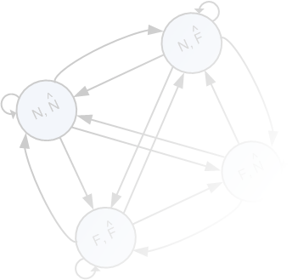
Imperfect Diagnosis
Conclusions
Background and Motivation
Network fault diagnosis
  Dependable end-user service provisioning in Next Generation Network architectures
  → Dominated by wireless networks, mobility and varying traffic conditions
  Challenged by unreliable observations and hidden network states
  Imperfect Diagnosis
Modelling imperfect diagnosis
  Goals of modelling
    Determine best remediation actions
    Determine best trade-off of imperfections
  Assess properties of a given diagnosis component
  (function level modelling [1], system level simulation [2])
  Light-weight models desirable for frequent model re-evaluations

Slide 3
Imperfect Diagnosis
Conclusions
Example: Decentalized Fault Management Framework
ODDR decentralized fault management framework [3] [4]
(Observation, Diagnosis, Decision and Remediation)
  End-node Driven Fault Management
  Joint view on imperfect diagnosis and decisions (remediation, observation collection )
  Operation in dynamic environment → frequent model re-evaluations
  → Subsequent focus on trade-off of imperfections (best diagnosis settings)

Slide 4
Background on Diagnosis Approaches
Conclusions
Definitions of Diagnosis Outcomes
Diagnosis atomic view
  Single observation
  Two network states (Normal/Fault)
  Discrete diagnosis steps (period T)
Generic Diagnosis (state estimation) definitions

Slide 5
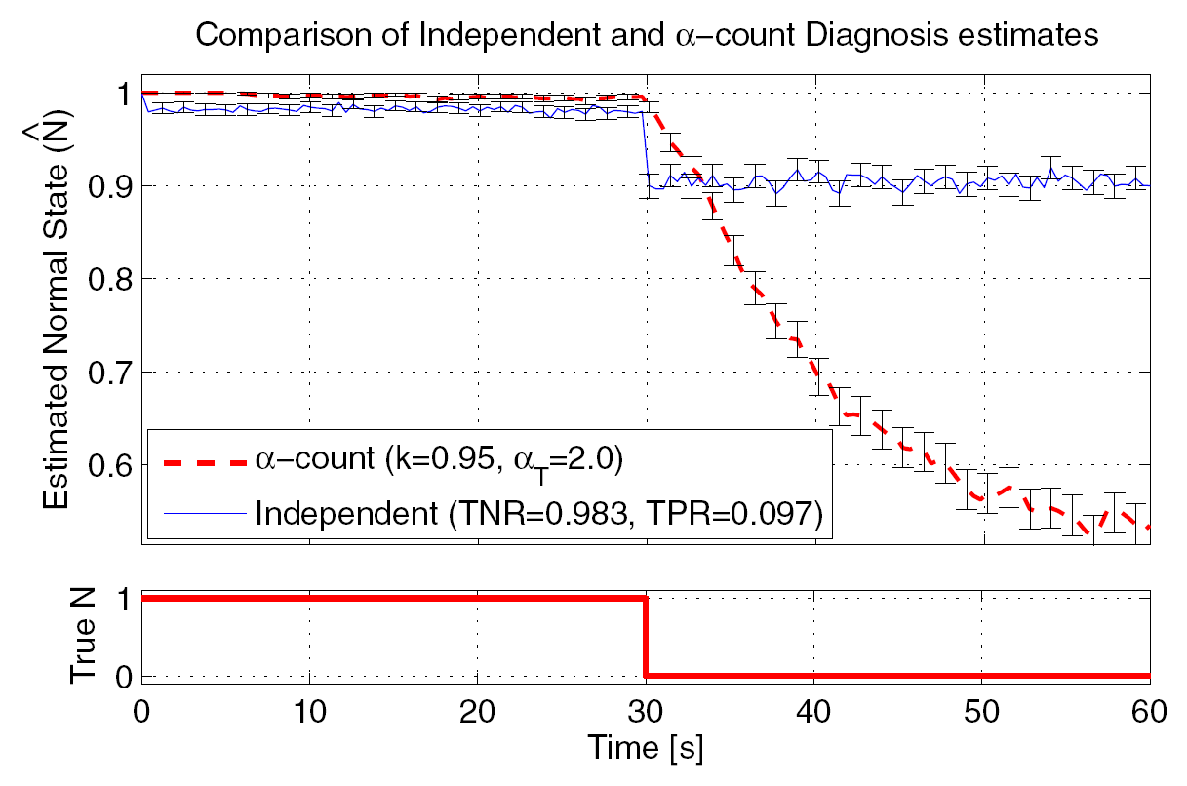
Background on Diagnosis Approaches
Conclusions
Diagnosis Classes
Two levels of complexity of diagnosis behaviour
  One-shot¹: diagnosis estimate based on a single set of observations in time
    No correlation of diagnosis estimates from diagnosis
    → Simple model representation proposed in [3]
  Over-time¹: diagnosis estimate based on new and old observations
    Means to improve diagnosis estimates
    Strong correlation added by diagnosis component
  Comparison
    One-shot: threshold on round-trip time (RTT)
    Over-time: α-count heuristic (Bondavalli et al. [1]) on one-shot estimates
    Transient effects from network neglected
    Over-time has highly transient phase; yet significant improvement
    Identify best trade-off: Reaction Time & False Alarms
    Simple parameterization from steady-state behaviour is difficult
2000 repetitions
¹ Terminology adapted from [5]

Slide 6
Parsimonious Diagnosis Model
Conclusions
Definition and Parameters
Four-state Markov model presented in [3]
  Controlled by geometric ON-OFF network state process
  (fault/repair occurence) {p_{f}, p_{r}}
  2 free parameters {P(TN|N_{s}=Normal) = TNR = (1-FPR), P(TP|N_{s}=Fault) = TPR = (1-FNR)}
Explore model capabilities
  Remediation assumption: fail-over on network fault state diagnosis
  6 free parameters
  fixed {p_{f}, p_{r}} → 4 free parameters
System Equations

Slide 7
Parsimonious Diagnosis Model
Conclusions
Diagnosis Metrics Definitions
Diagnosis Metrics
  Proposed Metrics (steady state)
    Probability on Remediation on False Alarm, (p_{RFA})
    Mean Remediation Reaction Time (μ_{RRT})
    → Note, two parameters and four free
  Diagnosis Trace
    Start diagnosis in normal network state for a given set {p_{f,} p_{r}}
    Observe until alarm is diagnosed
    Perform M repetitions and derive O=#FA
      p_{RFA} = O/M
      μ_{RRT}, mean time to remediation over all M

Slide 8
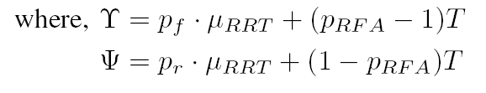
Parsimonious Diagnosis Model
Conclusions
Diagnosis Metrics Equations
Closed-form equations derived by linear algebraic approaches [6]
  Probability on Remediation on False Alarm (p_{RFA}) → Probability of absorption
  Mean Remediation Reaction Time (μ_{RRT}) → Mean time to absorption
  Solving yields two linear equations:
Initial state
Absorbing states

Slide 9
Parameterization by Diagnosis Metrics
Conclusions
Underdetermined problem solved by heuristics
  (MI) Minimize p_{FPTN} and p_{TPFN.} Minimize direct transitions TN→FP and FN→TP
Behaviour in transient analysis:
  Initial study parameters: T = 0.4s, Mean normal period= 12.42s, Mean fault period = 15 s
  Captures an initial higher probability of p_{RTA} over all alarms (p_{RTA+} p_{RFA})
p_{RFA}
minimize
p_{RTA}
p_{RTA}
(p_{RFA +} p_{RTA})
minimize

Slide 10
Case: Time Constrained Data Transfer
Conclusions
Background
QoS requirement: Complete SCTP based file transfer within t_{deadline} seconds with the probability: Ω
Fault: Congestion in operator infrastructure (occurrence and repair, ON-OFF model)
Remediation: Single fail-over from network A to network B
Diagnosis: Simple threshold based on RTT and α-count
Decision: Fail-over on network fault state diagnosis

Slide 11
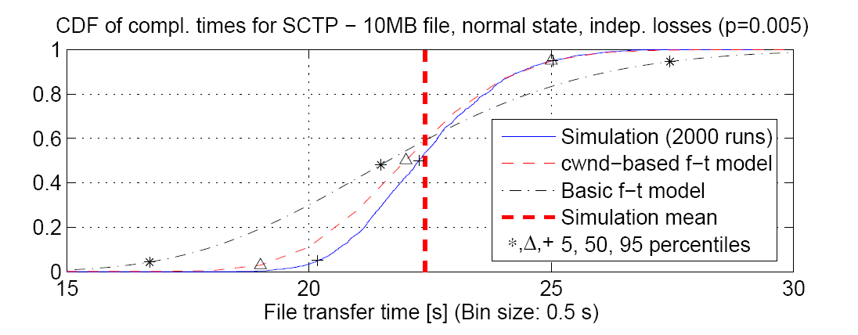
Case: Time Constrained Data Transfer
Conclusions
Policy Evaluation Model
Policy Evaluation Discrete Time Markov Model (PE DTMC) [3]
  State Space:
  S_{PE} = {Active network, Time progress, File progress,
  Network state, Diagnosis state}
Ω_{model} = Σ S_{PEss}(r, n)
m
r =1
File Transfer Completion Time CDF

Slide 12
Model Sensitivity Analysis
Conclusions
Model based sensitivity analysis on Ω
  Vary μ_{RTT} and p_{RFA}, t_{deadline} = 30s & file_{size}=10 MByte
  Compare to perfect diagnosis and no-failover policy
  Both metrics have a clear impact on Ω, μ_{RTT} → promptness and p_{RFA} -> correctness
  Most sensitive to high p_{RFA} → wrong fail-over cannot be remediated
  Can deliver significantly worse performance than no fail-over
Perfect Diagnosis
No fail-over

Slide 13
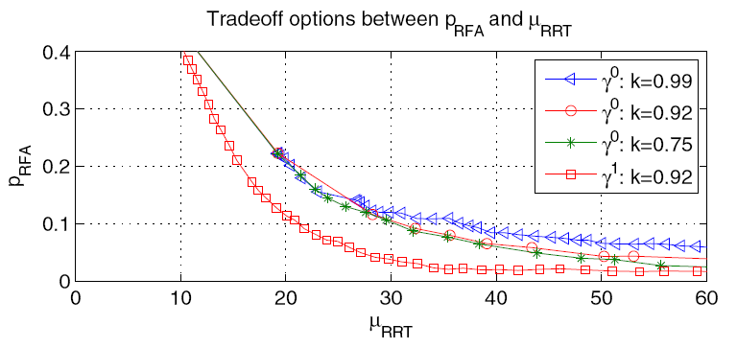
Reliability Evaluation Results
Conclusions
Background & Trade-off Results
Study properties of α-count diagnosis component
  α-count → controlled by two parameters: k → forgetting factor, α_{T} → threshold
  PE DTMC Model based analysis
  Simulation based analysis
    System level simulation based on ns-2
    Provide evaluation of Ω and traces of diagnosis performance
  Consider two settings of one-shot diagnosis:
Tradeoff options of a-count (obtained from single trace set, 2000 runs)
γ⁰ = (TPR, TNR) = (0.983, 0.097)
γ¹ = (TPR, TNR) = (0.953, 0.225)

Slide 14
Reliability Evaluation Results
Conclusions
Background & Trade-off Results
PE DTMC model based analysis
  Simple threshold
    γ⁰ performs better than γ¹ (as shown in [3])
  α-count
    Overall leads to improvement
    → filtering out false alarms
    Optimal settings exist
    γ¹: k=0.92, a_{T}=2.5 leads to best results
    →Obtainable reduction of p_{RFA} without similar
    increase in μ_{RTT}
Simulation based analysis
  Consistent conclusions to model
  Qualitative differences
    stochastic time model
    Simplified data-transfer model
Ω_{model}
Simple threshold
Threshold α_{T}
Ω_{simulation}
Threshold α_{T}

Slide 15
Conclusion & Outlook
Conclusions
Conclusions
  Proposed parsimonious imperfect diagnosis model for light-weight assessment of best diagnosis component settings; also considering complex class of over-time diagnosis components
  Defined representative imperfect diagnosis performance metrics and derived their closed-form equations in the model
  Presented service reliability case and performed model based sensitivity analysis of reliability on imperfect diagnosis performance metrics
  Used model to assess diagnosis performance properties of over-time diagnosis heuristic from literature and define best setting
  Shown by system level simulation analysis that diagnosis model can capture essential imperfect diagnosis performance characteristics
Outlook
  Introduce more complex decision policies
    Application state information → minimize remediation
    Multiple fault diagnosis
    Decisions to collect more information
    → Need to study diagnosis model behaviour after positive diagnosis and potentially extend

Slide 16

Questions & Discussion
Conclusions

Slide 17
References
[1] Threshold-based mechanisms to discriminate transient from intermittent faults. A. Bondavalli, S. Chiaradonna, F. Di Giandomenico, and F. Grandoni, IEEE Transactions on Computers, vol. 49, no. 3, pp. 230–245, 2000.
[2] Probabilistic Fault-Diagnosis in Mobile Networks Using Cross-Layer Observations. A. Nickelsen, J. Grønbæk, T. Renier, and H.-P. Schwefel, “” In Proceedings of AINA 09, pp. 225–232, 2009.
[3] Model based evaluation of policies for end-node driven fault recovery. J. Grønbæk, H.-P. Schwefel, and T. Toftegaard, Proc. DRCN 09, 2009.
[4] Towards self-adaptive reliable network services in highly-uncertain environments. A. Ceccarelli, J. Grønbæk, L. Montecchi, A. Bondavalli, and H. P. Schwefel, To appear in proceedings of WORNUS 10, May, 2010.
[5] Hidden Markov Models as a Support for Diagnosis: Formalization of the Problem and Synthesis of the Solution. A. Daidone, F. Di Giandomenico, S. Chiaradonna, and A. Bondavalli, in 25th IEEE Symposium on Reliable Distributed Systems, 2006. SRDS’06, 2006, pp. 245–256.
[6] Queueing Theory – A Linear Algebraic Approach. L. Lipsky, 2nd ed. Springer, 2009.
,,

